Slide 1
Up on the Roof
Recent advances in
rooftop unit controls
Jay Stein
Executive Vice President, E Source
Cooling Efficiency Workshop
Thursday, April 17, 2014

Slide 2
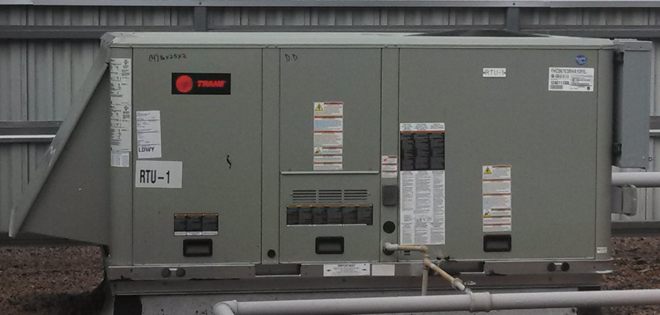
What’s So Special About This RTU?
Source: Trane

Slide 3
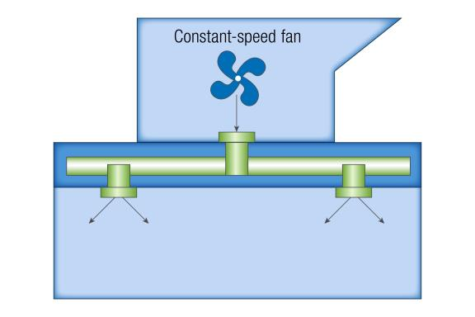
Single-Zone Constant Volume (CV)
One zone
Fixed fan speed
Fan either on or off
© E Source

Slide 4
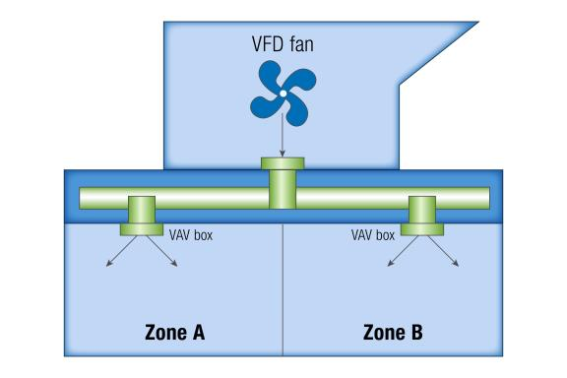
Multizone Variable Air Volume (VAV)
Multiple zones
Variable fan speed
Fan speed based on duct pressure
© E Source

Slide 5
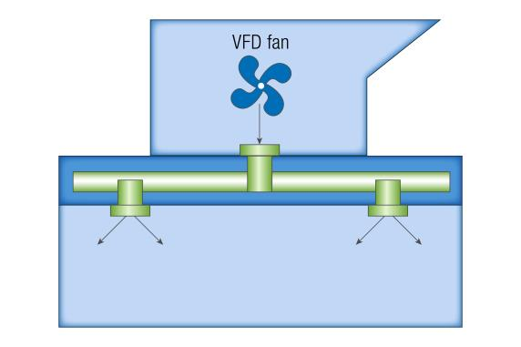
Single-Zone Variable Air Volume (SZVAV)
One zone
Variable fan speed
Fan speed based on
ΔT between setting
and actual room temperature
Low speed when
neither heating nor
cooling is called for
© E Source
Notes:
Fan speed ideally controlled based on difference between indoor air temperature and temperature setting
Sometimes done that way, more frequently multi-stage thermostat used
Fan speed staged in steps
Usually a VFD used and that’s the ideal; could use multispeed motors
Ideally, a variable- speed compressor used
More frequently, either staged compressor used, or just get along without any compressor control
Same with heating, better with variable capacity, but sometimes just get along with on-off

Slide 6

Advantages of SZVAV
Reduces energy consumption
  SEER boost 2.5 points
  At least 20% energy savings
Helps compensate for oversizing
Improves dehumidification
Reduces fan noise
Reduces complexity
Courtesy: Clker.com
Notes:
Worth about 2.2 to 2.5 points of SEER, from 15.0 to 17.5
Overall energy savings usually more, usually at least 20% but often greater
Integrated economizer
Demand-controlled ventilation
Some offer Variable-speed compressor

Slide 7
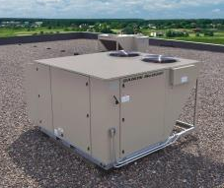
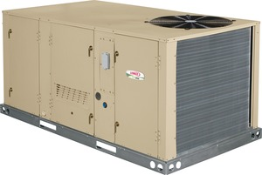
Where Can You Get a SZVAV?
Aaon
Carrier
  Centurion
Daikin/McQuay
  Rebel
Lennox
  MSAV
Trane
  Precedent Plus
York
Courtesy: Daikin/McQuay
Source: Lennox
Notes:
Some have two-speed fans, some have variable-speed operation
Some vary compressor speed, some don’t

Slide 8
Size Matters
Where to use SZVAV:
Single-zone units
7.5 tons or larger
  Occasionally cost-effective as low as 5 tons
Long run hours
  24/7 the best
  Office hours (M-F, 9-5) are on the bubble
Oversized
  The more excess capacity, the greater the savings
Notes:
Utility incentives can change these criteria

Slide 9
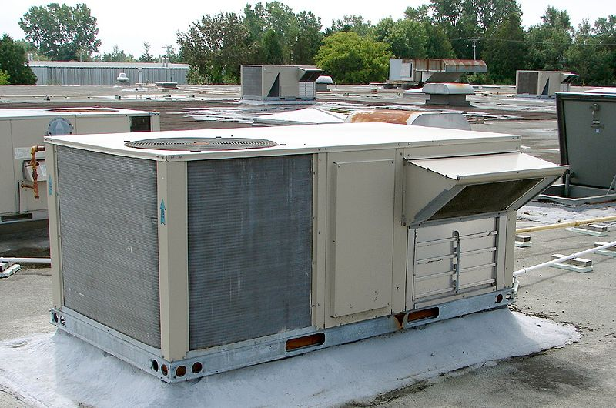
What About All Those Existing Units?
Source: Wikimedia Commons
Notes:
More commercial buildings are cooled by this equipment than any other type, but they’ve got a problem. Their fans run all the time at full power when the buildings they condition are occupied.

Slide 10
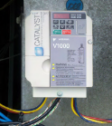
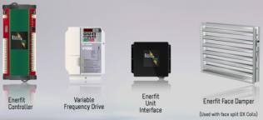
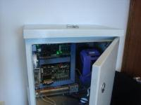
RTU Variable-Frequency Drive
Retrofit Devices
Catalyst
  Transformative Wave Technologies
Enerfit
  Enerfit LLC
Digi-RTU Optimizer
  Bes-Tech (DTL Controls)
Source: Transformative
Wave Technologies
Source: Enerfit
Source: Bes-Tech
Notes:
Several associated with some well-known names in HVAC circles
Catalyst: Reid Hart and his premium ventilation package and western premium economizer
Digi-RTD: Dr. Liu, Texas A&M continuous commissioning
Optimum: Tom Hartman
For single-zone HVAC units only.
Min about 10 tons, max ?

Slide 11
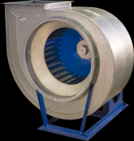
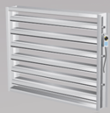
Different Strokes for Different Folks
Product | VFD evaporator fan | VFD compressor | VFD type | Damper for coil 2
Catalyst | ✓ |  | Indexed
Enerfit | ✓ |  | Continuous | ✓
Digi-RTU | ✓ | ✓ | Continuous
Note: VFD = variable-frequency drive.
© E Source
Source: Wikimedia Commons
Source: Enerfit
Notes:
Compressor – not done before because of equipment damage concerns
Demand-controlled ventilation
Integrated economizer control
Web control and monitoring
Fault detection and diagnostics

Slide 12
They’re Not Modest
Product | Annual HVAC energy savings | Simple payback period
Catalyst | 25–40% | 2 years
Enerfit | 50–70% | 1–3 years
Digi-RTU | 50% | 1–4 years
© E Source
Notes:
Costs run about $400 to $600 per ton

Slide 13
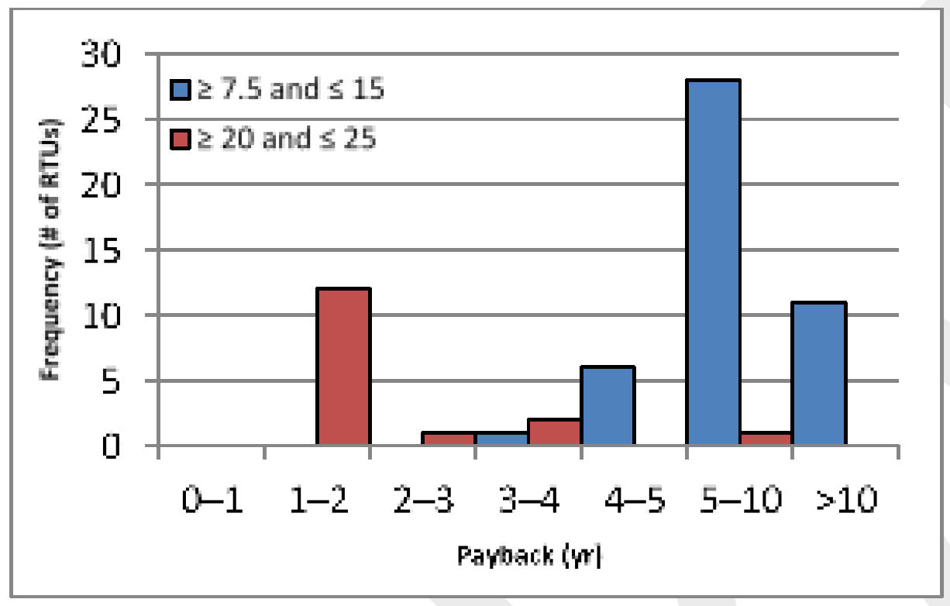
Finally, from PNNL, a Definitive Study
Number of RTUs tested: 66
Building types: mercantile, office, food sales, healthcare
Savings varied widely: 22% to 90%
Average savings: 55%
Average simple payback period: 3 years
Source: Pacific Northwest National Laboratory
Notes:
Conducted by PNNL
Size range: 5 to 25 tons

Slide 14
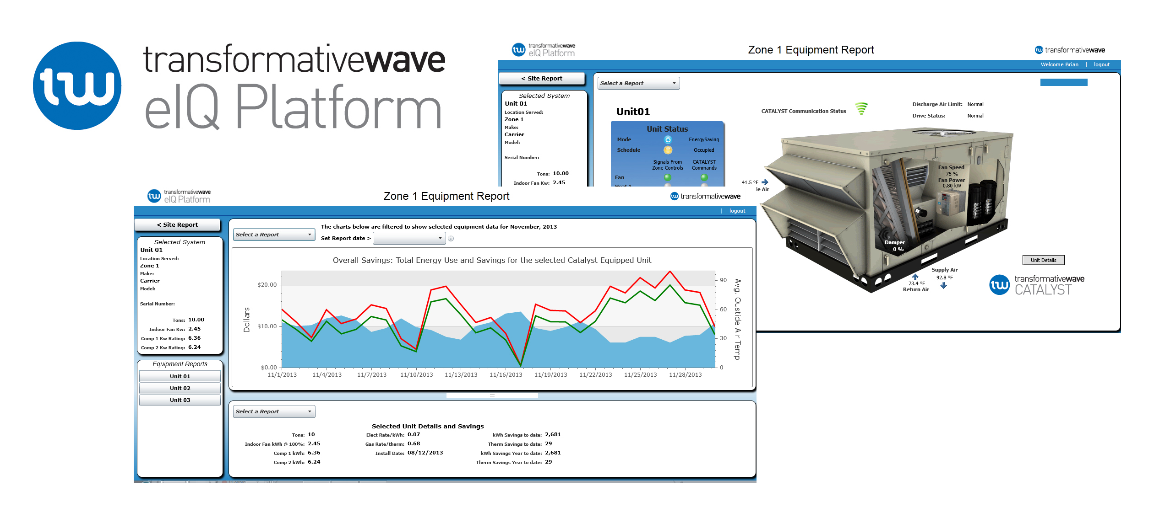
In Addition to Energy Efficiency
Courtesy: Transformative Wave Technologies
Notes:
Wireless rooftop network
Real- time connectivity
40 points of data
One-minute interval histories
Real-time power monitoring
Savings estimation
Diagnostics and analytics
Remote notification
Preventive maintenance
Demand reduction

Slide 15
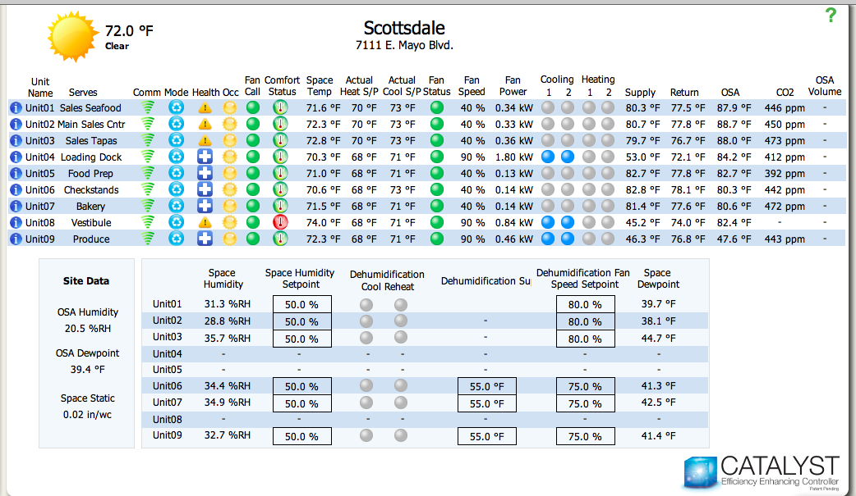
System Monitoring
Courtesy: Transformative Wave Technologies

Slide 16

The Problem
Source: Cartoonaday.com

Slide 17
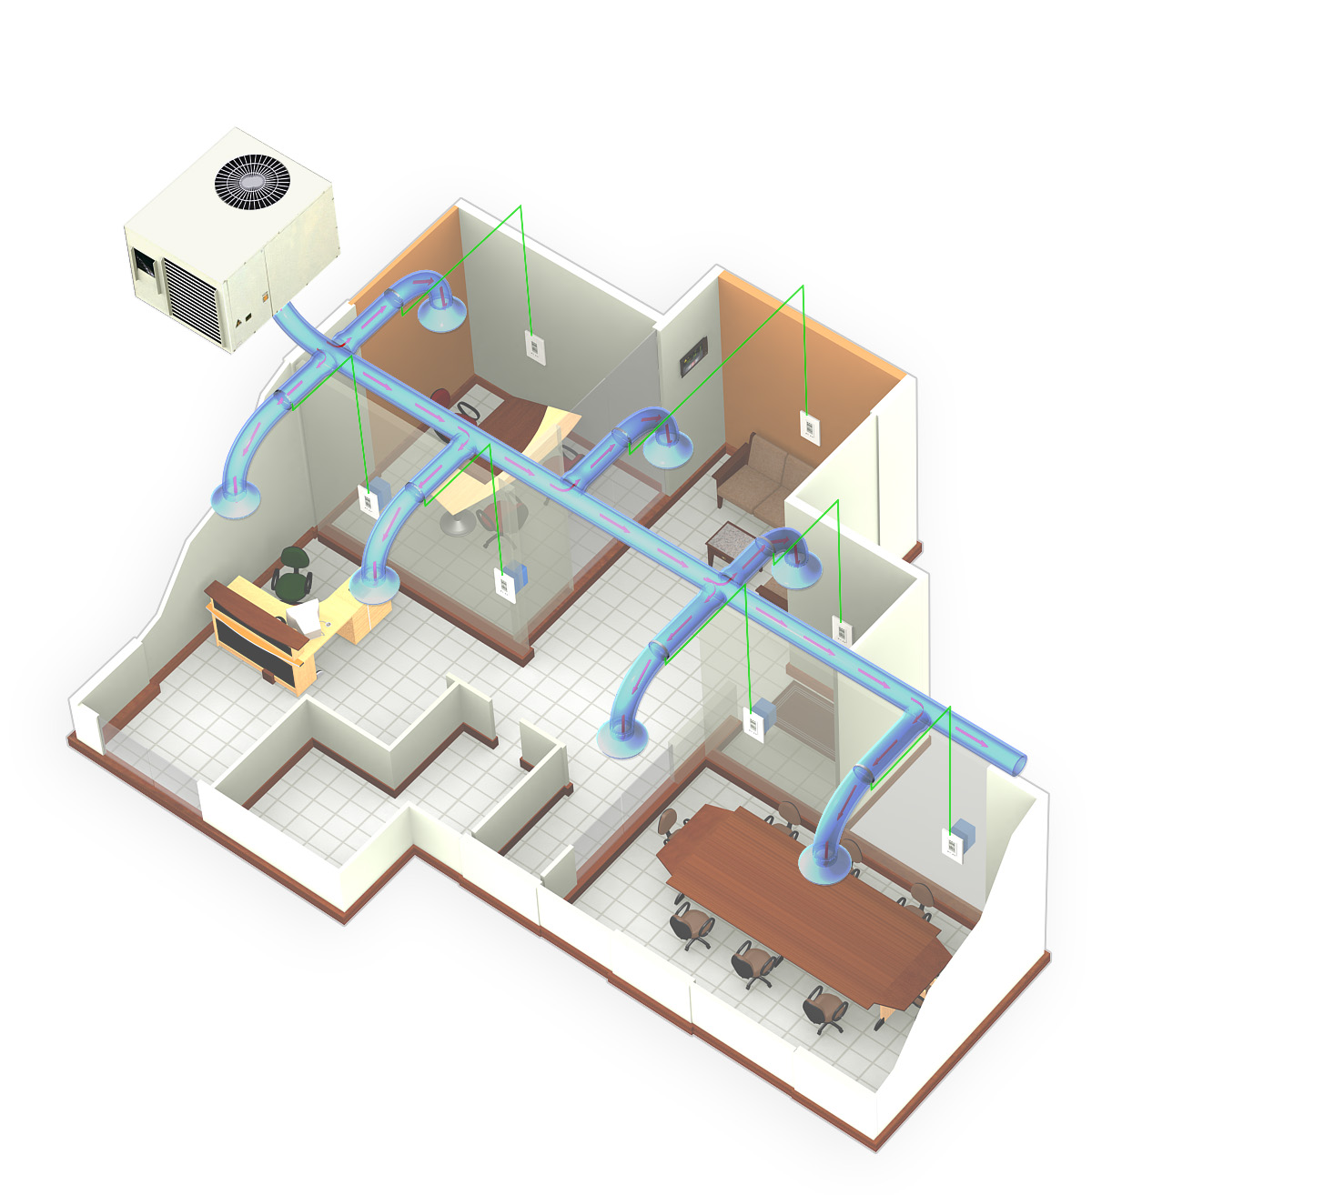
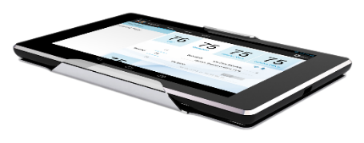

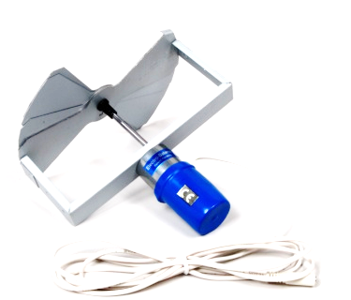
A New Solution
Courtesy: 75F

Slide 18
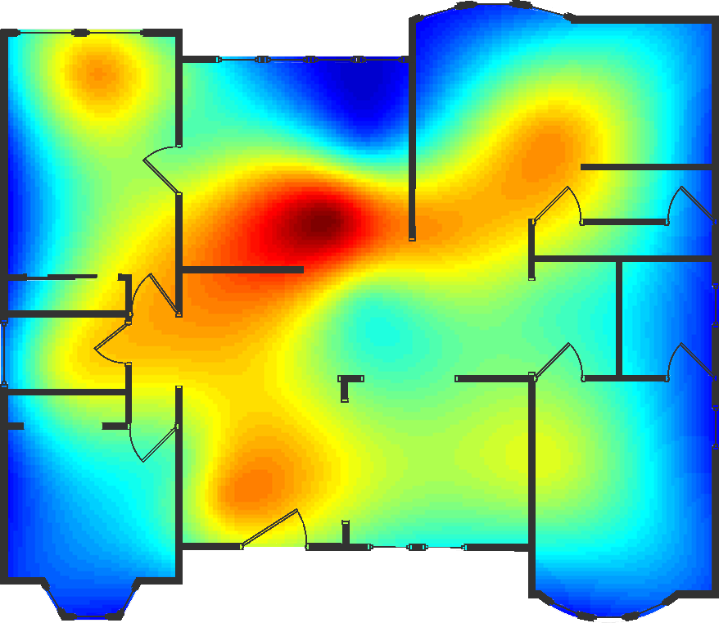
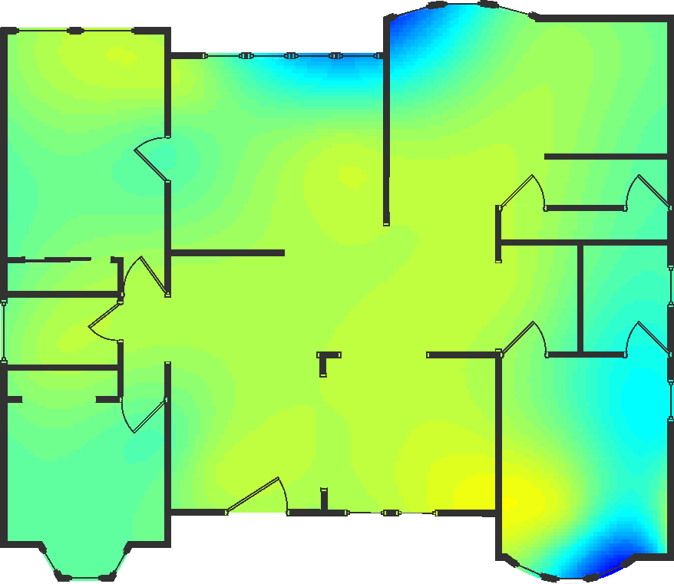

Dynamic Balancing from 75F
Before
After
Courtesy: 75F

Slide 19

For More Information
Jay Stein
Executive Vice President, E Source
303-345-9131
jay_stein@esource.com
Have a question? Ask our experts: www.esource.com/question

